Slide 1
Pitch

Slide 2
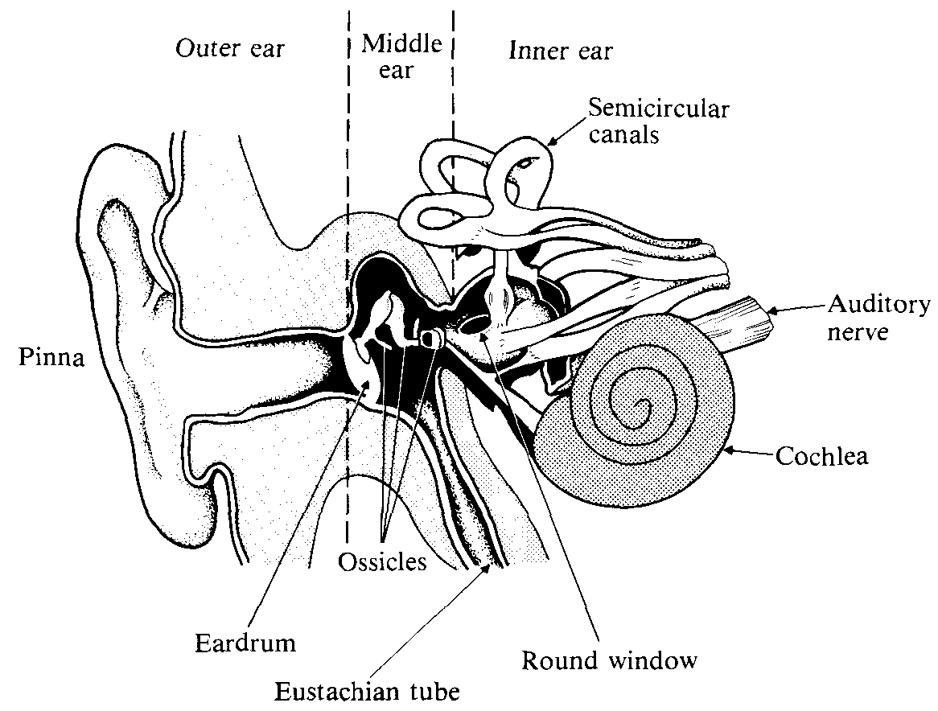
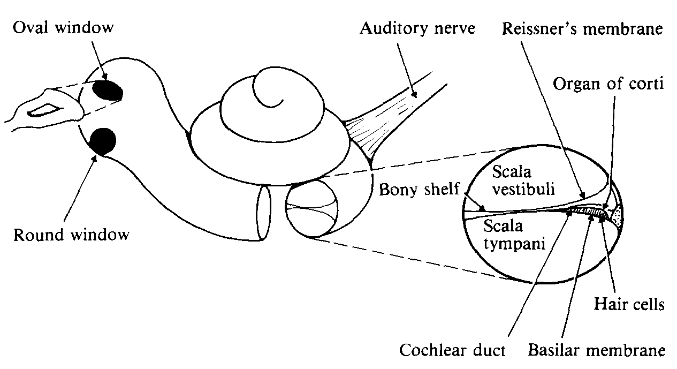
Ear
(Rossing 1990: 66, 68)

Slide 3
Pitch
pitch of complex tones
fundamental and 'missing fundamental'
analytic and synthetic hearing
examples: canceled harmonics; overtone singing
'cocktail party' effect
pitch in the case of inharmonicity
circularity in pitch judgment

Slide 4
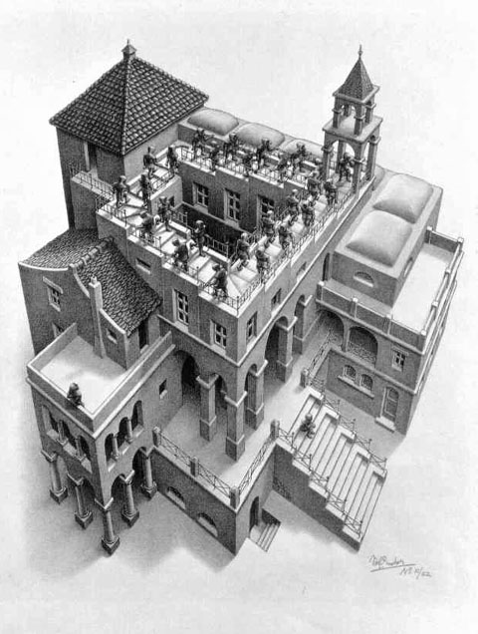
Pitch
pitch of complex tones
circularity in pitch judgment

Slide 5
Pitch
pitch perception theories
telephone theory '
place theory
periodicity theory
pattern recognition
virtual pitch

Slide 6
Pitch
just noticeable differences (jnd) in pitch

Slide 7
Pitch
pitch and other attributes
pitch and sound level
pitch and duration

Slide 8
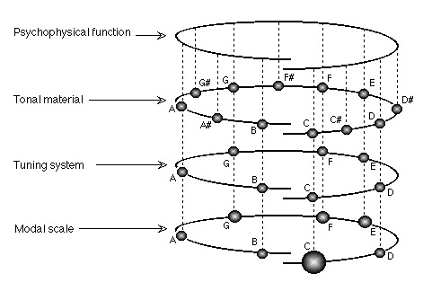
Tonal Hierarchy
four levels
(Dowling & Harwood 1986, etc.)

Slide 9
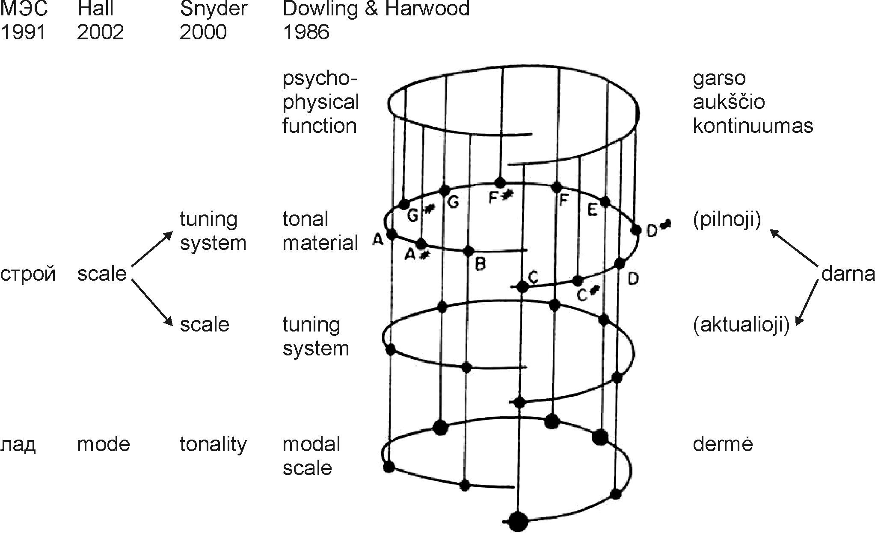
Tonal Hierarchy
four levels

Slide 10
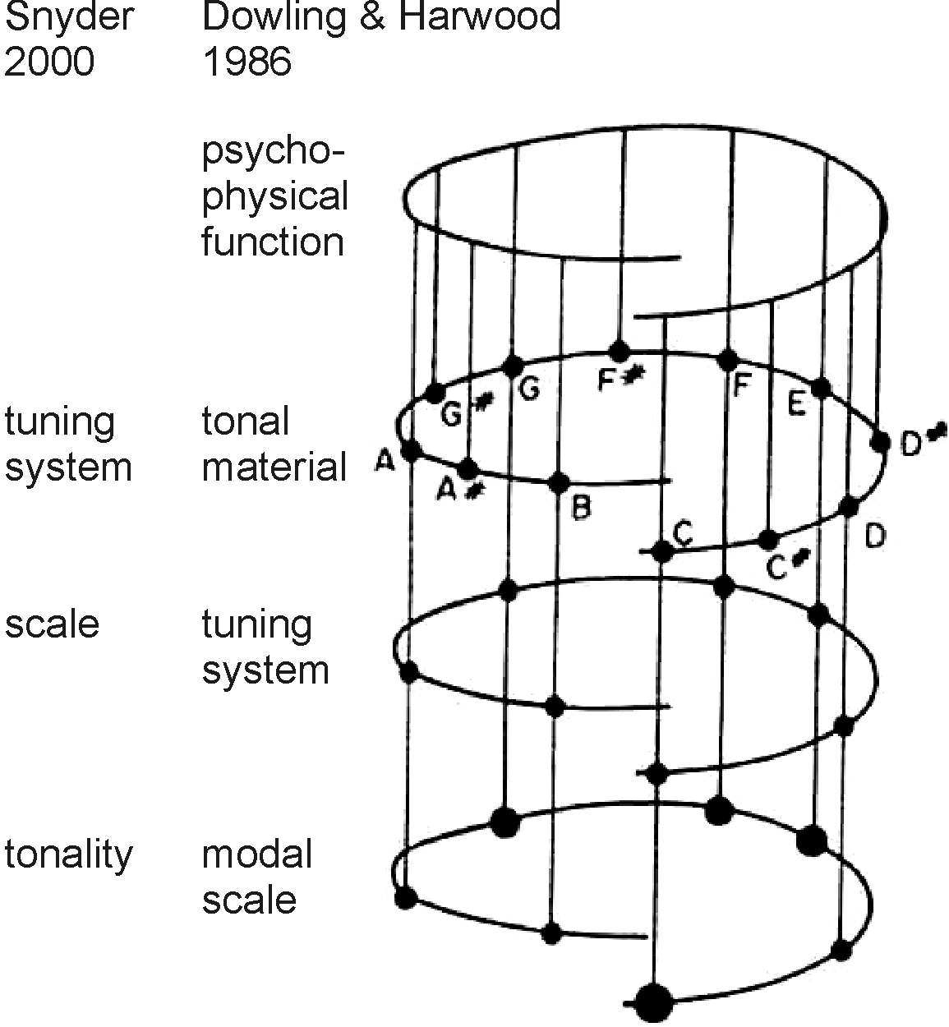
Tonal Hierarchy
psychophysical function
The psychophysical pitch function assigns pitches to frequencies (Dowling & Harwood 1986: 113)

Slide 11
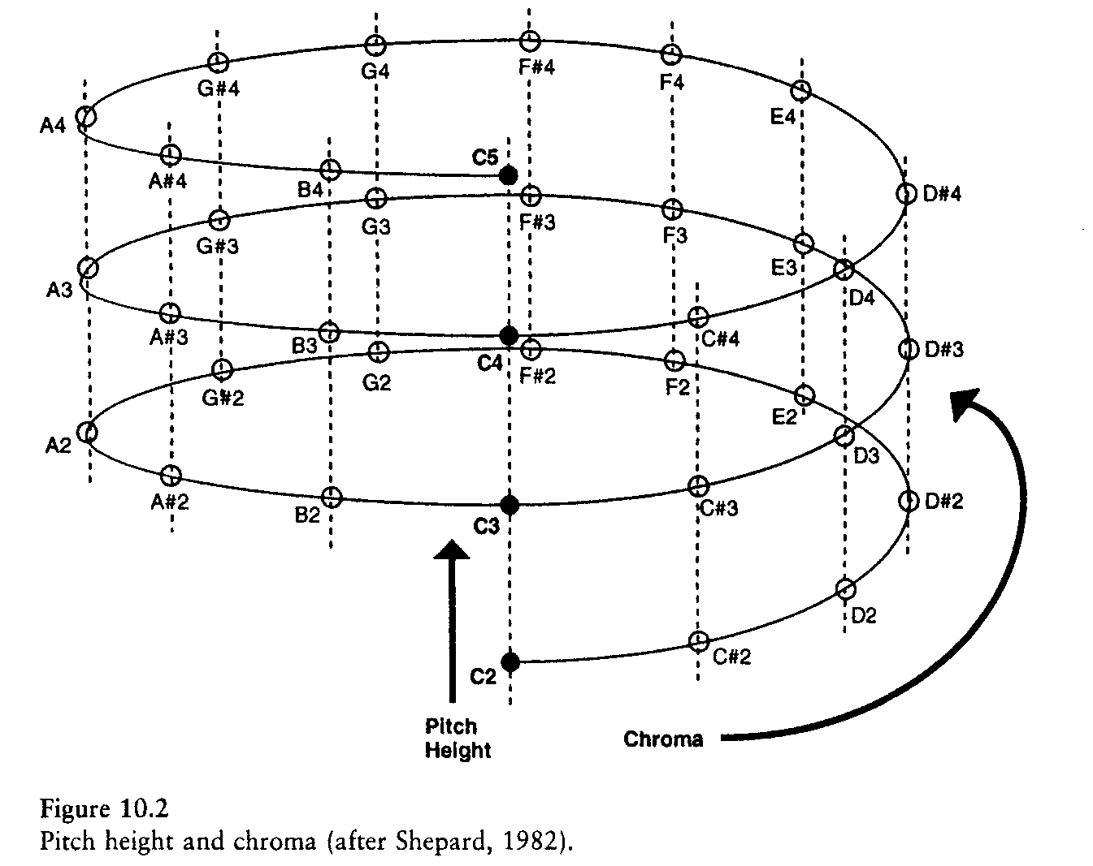
Tonal Hierarchy
psychophysical function
The psychophysical pitch function assigns pitches to frequencies (Dowling & Harwood 1986: 113)
(Snyder 2000: 131)

Slide 12
Tonal Hierarchy
psychophysical function
pitch helix
two dimensions of pitch: height and chroma
the octave: a special interval (octave equivalence)
(Snyder 2000: 131)

Slide 13
Tonal Hierarchy
tonal material
The tonal material consists of all the possible pitches that could be used in melodies (Dowling & Harwood 1986: 113)
A tuning system defines the size of the smallest allowable musical interval (Snyder 2000: 135)
characteristic of a given musical culture
→ hearing as an “out of tune”
example: slendro

Slide 14
Tonal Hierarchy
tonal material
the need of categorization?

Slide 15
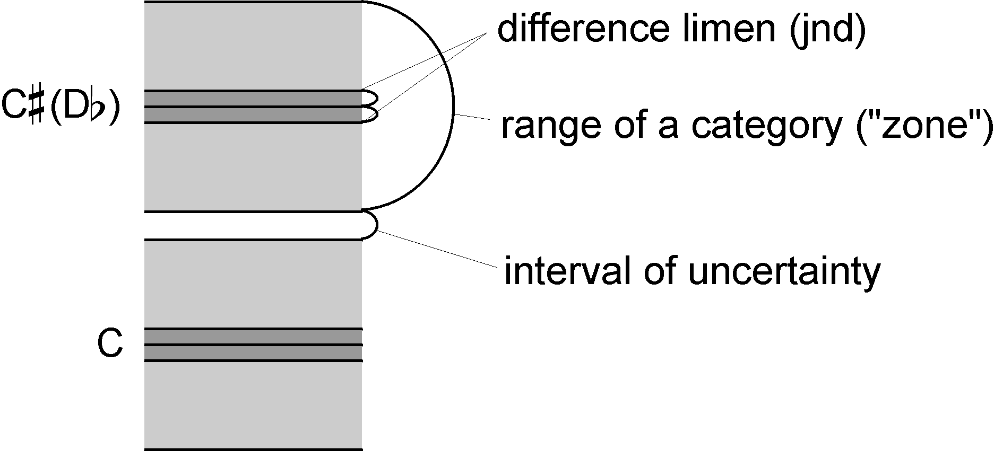
Tonal Hierarchy
tonal material
the need of categorization?
structure of a category
nuances and “out-of-tune”-ness

Slide 16
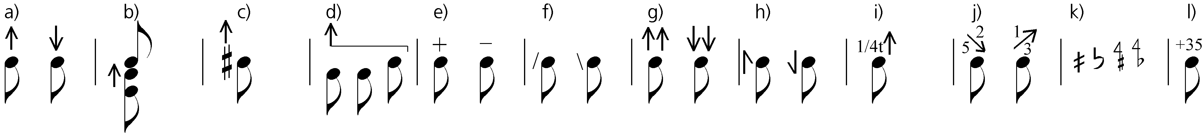
Tonal Hierarchy
tonal material
categories and nuances in transcription

Slide 17
Tonal Hierarchy
tuning system
The tuning system consists of a subset of the pitches that are used as the basis of modal scales (Dowling & Harwood 1986: 113)
A scale is a subset of the pitches of a tuning system (Snyder 2000: 135)

Slide 18
Tonal Hierarchy
tuning system
special cases: e.g., Hindu raga:
“a scale plus rules for melodic motion and ornamentation” [...] “that which colors the mind” (Snyder 2000: 139)
the need of tuning system?
preference for interval asymmetries:
“these asymmetries act as orientation points so that we can know “where” we are in the scale” (Snyder 2000: 139; Krumhansl 1990: 16-18)

Slide 19
Tonal Hierarchy
tuning system
the number: why 7 pitches in diatonics? 5 in pentatonics? not frequently 3? never 35 or 100? 22 Hindu sruti?
scales and short-term memory: Miller’s “magical number” 7±2

Slide 20
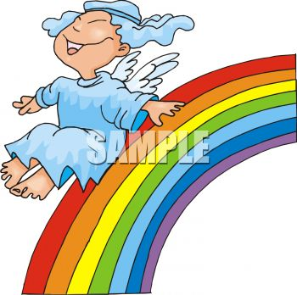
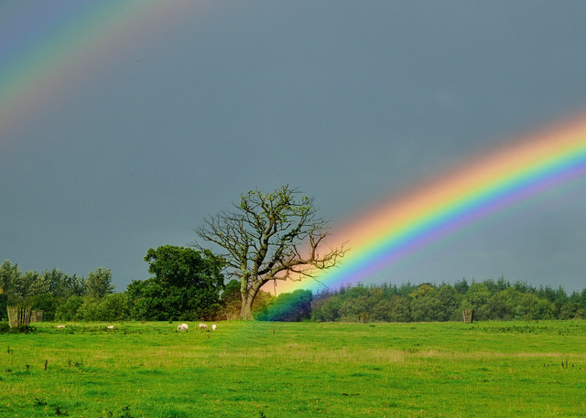

Tonal Hierarchy
tuning system
Miller’s “magical number” 7±2

Slide 21
Tonal Hierarchy
modal scale
The modal scale organizes hierarchically the pitches of a tuning system (Dowling & Harwood 1986: 113-114)
A tonality is a way of using a musical scale so that it seems to have a central pitch (Snyder 2000: 136)

Slide 22
Tonal Hierarchy
modal scale
tonal weight (relative importance, salience)
tonality only exists in time!
(multiparametric reinforcement: longer notes, occurrences in important metric positions, etc.)
tonality and implicit memory: role of prolonged exposition

Slide 23
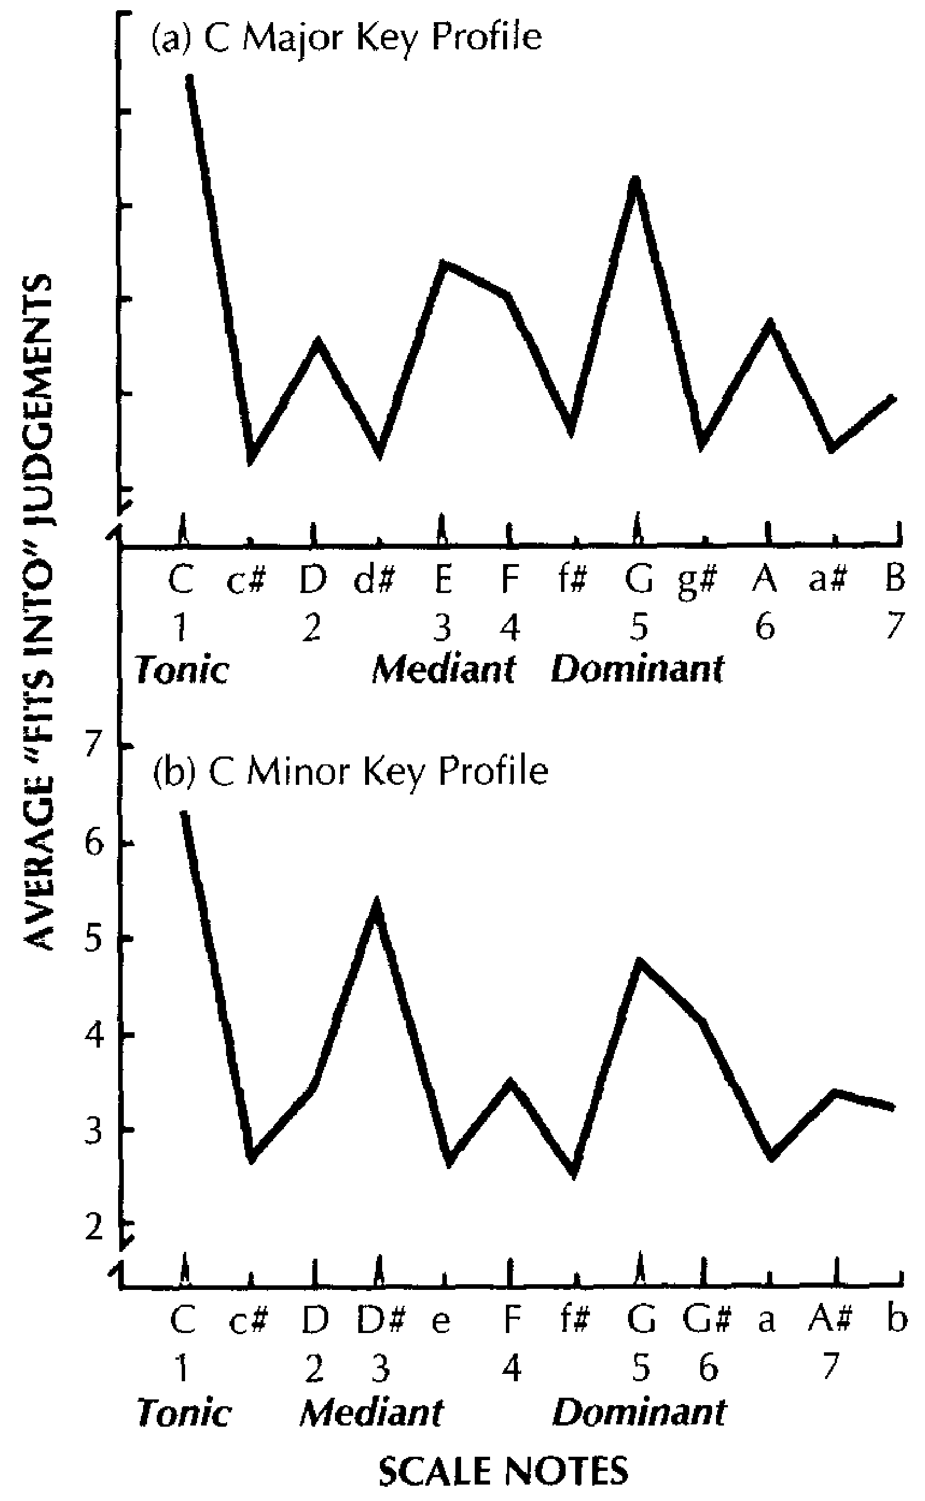
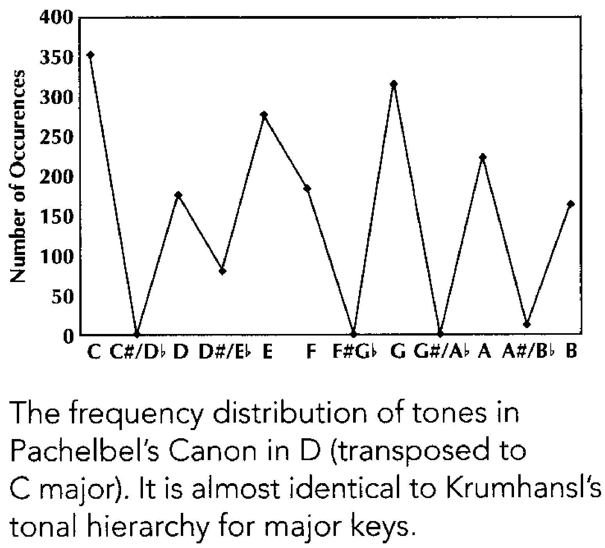
Tonal Hierarchy
modal scale: Krumhansl’s tonal profiles
(adapted from Krumhansl & Kessler 1982)
(Thompson 2009: 110)

